Slide 1



INTELLIGENT
CARPARK GUIDANCE
SYSTEM
LIQUIDPARK
Web : www.liquidlab.in
Email : info@liquidlab.in
Phone : 08050489585
Designed &Developed By:
LIQUIDLAB INFOSYSTEMS
BANGALORE

Slide 2
COMPANY PROFILE
Startup - Established in 2015
Team members with wide experience in software & hardware development.
Have experience in working with global leaders in Parking systems for some of the busiest carparks in the world like
Deira City Centre - 6000 Spaces
Mall Of Emirates – 7000 spaces
Dubai International Airport Terminal 1,2,3 - 5300 Spaces

Slide 3
SYSTEM BRIEF
Provides the drivers with the real-time & accurate information of available parking space.
Guide them to the nearest space available through the shortest route with the help of directional displays at strategic locations.
Provides space by space availability indication using ultrasonic detectors & pilot lights.
Provides detailed statistics and reports on the carpark usage and events.

Slide 4
SYSTEM OBJECTIVE
Guide the driver to the nearest free parking space more efficiently.
Fully optimize the use of existing carparking space
Reduce chaos and congestions at the parking area.
Create a better impression about the parking.
Reduce the manpower required for manual guidance.

Slide 5
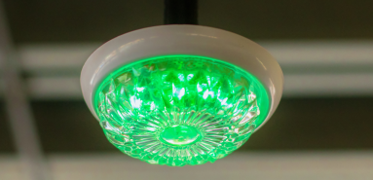
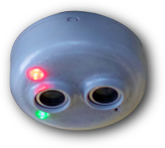

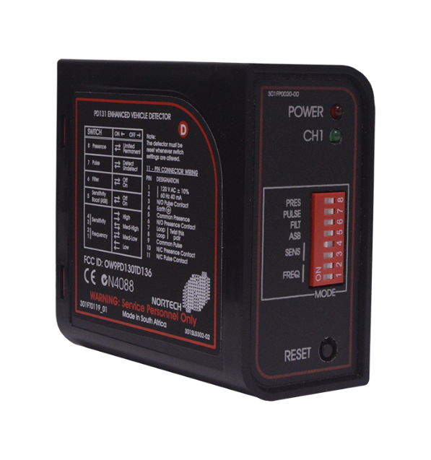
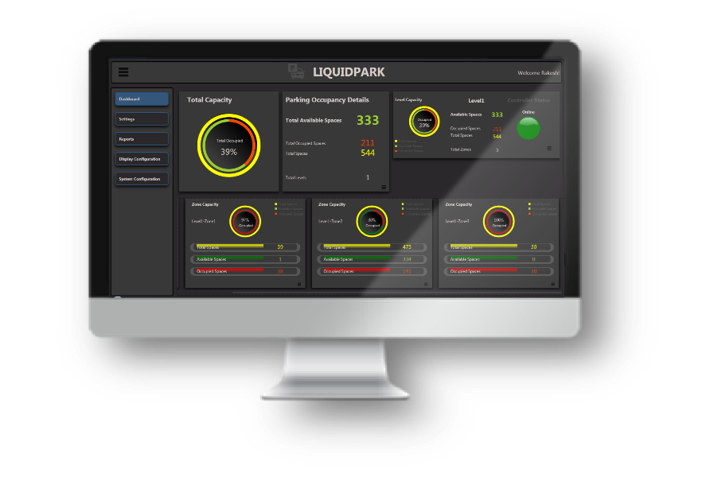
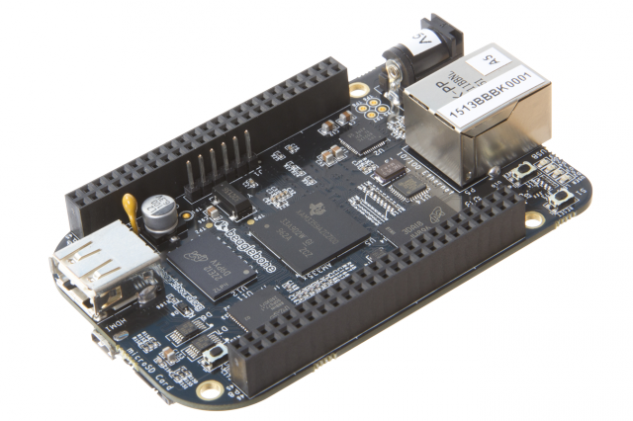
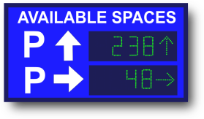
SYSTEM DESIGN
Central server with Database & Management Application.
Main Controller / Level Controller (Only one per level)
Induction Loop Detector (On Entrance & Exits of Zones)
Variable message Signs (At strategic locations)
Ultrasonic detectors with pilot light (on each carpark space).
Pilot Light Green
Ultrasonic Detector
Pilot Light Red
Server with Database & Management Application
Main Controller / Level Controller
Induction Loop Detector
Variable Message Signs

Slide 6
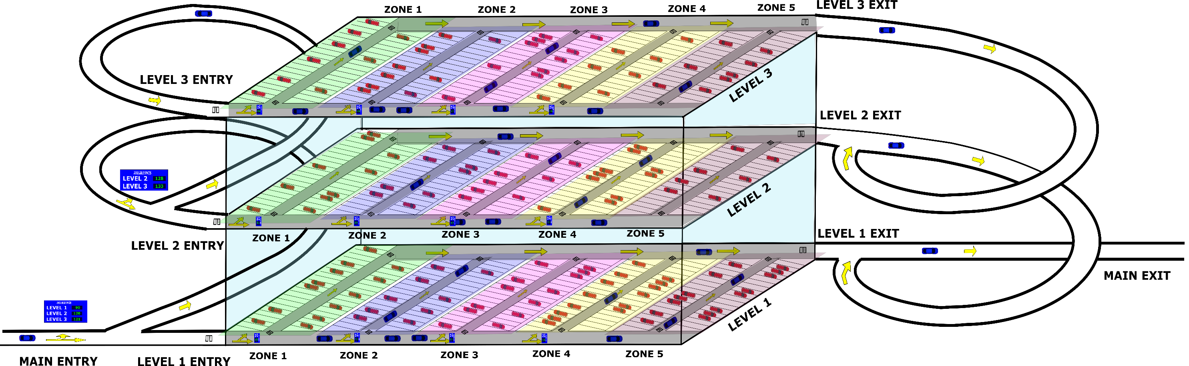
WORKING PRINCIPLE
TOTAL LEVELS - 3
TOTAL SPACES - 522 (174*3)
TOTAL PARKED CARS - 153 (64+44+45)
TOTAL CARS IN DRIVEWAY - 28 (10+8+10)
TOTAL CARS INSIDE PARKING - 181 (153+28)

Slide 7
SYSTEM FEATURES
Faster booting & execution.
Retains data & configuration.
Direction detection logic.
Module based architecture.
IP based components.
User friendly graphical user interface.
Open to third party system integration.
Can modify zone occupancy during run time.
Real-time status monitoring & remote management
Statistics of individual zones & levels.
Highly customizable.

Slide 8
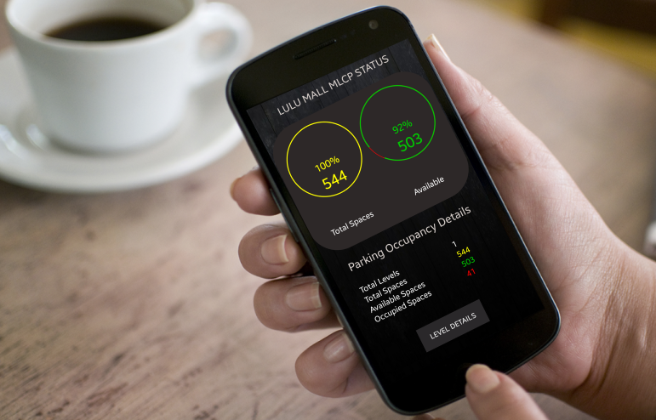
ADD-ON FEATURES
Android , IOS Applications and web portal to provide real time parking status to the customers.
Can be Integrated with lighting system inside the parking to switch off lights when a particular zone or level isthe empty.
Site specific features.

Slide 9
COMPARISON WITH SPACE BY SPACE SYSTEM
PARAMETER | LIQUIDPARK PGS | SPACE BY SPACE PGS
SYSTEM COST | LOW (Sensors are required only at the entrance and exits of the zones) | HIGH (Need ultrasonic sensors and status LEDs for each carpark)
INSTALLATION COST | LOW (Data and Power cabling requirements are less due to the low number of sensors and controllers.) | HIGH (Data & Power cabling requirements are high).
DATA ACCURACY | GOOD (98% and Above) (Use direction detection logic to achieve this accuracy.) | GOOD (98% and above)
RELIABILITY | HIGH (The parking count data includes all the vehicles which are parked and those in the parking aisle in search of space.) | MODERATE (The parking count data includes only the vehicles which are parked. Doesn’t keep account of vehicles which are in the parking aisle. This data can be unreliable for carparks which often gets full.)

Slide 10
THANK YOU

